Slide 1
HYINHEAT project
introduction
Subtitle
Name

Slide 2

The project in brief
Title: Hydrogen technologies for decarbonization of
industrial heating processes
Acronym: HyInHeat
GAP No.: 101091456
Call: HORIZON-CL4-2022-TWIN-TRANSITION-01-17
Start/End: 01/01/2023 to 31/12/2026 (48 months)
Total budget: 23.96 Mio. €
EU contribution: 17,71 Mio. €
Coordinator: RWTH Aachen University

Slide 3
Overall goals
Significant reduction of CO₂ emissions of the industrial processes with H₂ heating
NO_{x} levels of the processes at least not higher than the equivalent fossil fuel based solutions
Improved energy efficiency of the industrial processes
Significant reduction of H₂ fuel consumption of the developed process with regards to the current fossil fuel demand
Competitive costs of the developed technologies

Slide 4
The team
3 Steel and 5 Aluminium producers
9 Technology suppliers
4 Research and Technology organisations
4 Universities
2 European associations
1 Green Innovation Consultant & Marketing expert
In total: 28 partners from 12 countries

Slide 5





















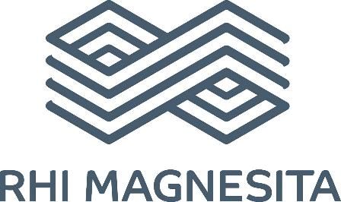








The partners

Slide 6
The challenges
Gas-solid or gas-liquid interactions between furnace atmosphere and product | impact on refractory products and furnace materials | condensation of off-gas | heat transfer and temperature homogeinity | high-temperature chemistry for H2/O2 combustion | feed-forward and feed-back combustion control | higher combustion temperatures | higher NOx formation rates | NOx emission limit definition | emission measurement technology | safety and risk assessment | flame detection and monitoring
‘‘HyInHeat uses a cross-sectorial approach addressing all the crucial tasks for an energy- and ressource efficient integration of H₂ in two large European sectors, Steel and Aluminium, to be an integral part of the heating solutions throughout the processes of the value chains of the two sectors’’

Slide 7
The objectives
Redesign heating processes for H₂ as fuel
8 demonstrators for H₂ heating | 1 full off-gas system redesign | 1 greenfield reheating furnace design study | 2 retrofit design studies
Modify heating equipment and infrastructure for use of H₂
4 burner modifications and optimizations | measurement instrumentation development for fuel supply and combustion control | H₂ compatible fuel supply implementation | refractory investigation and optimization
Develop O₂ combustion processes to improve efficiency
6 demonstrators with pure O₂ as oxidizer | 1 demonstrator with oxygen-enhanced combustion
Integrate instrumentation to characterize fuel composition & flow
2 measurement technologies for fuel quality | combustion control instrumentation development | NOx emission measurement technology development | predictive emission monitoring
Prove economic viability compared to heating alternatives
Demonstrators as baseline | comparison on basis of KPIs | individual business case evaluation

Slide 8
Value chain
Production processes Steel sector
HYINHEAT pilot/full-scale demonstrators:
ladle preheating
reheating
heating
annealing or galvanizing
liquid metal transfer
remelting / holding
refining
annealing
HYINHEAT full-scale design studies:
reheating
annealing or galvanizing
remelting / holding
homogenizing and reheating
flat products
1
2
1
4
2
Ironmaking (BF)
Steelmaking
(BOF shop)
Continuous Casting
Hot Rolling
Cold Rolling
Annealing
Finishing
3
1
Thin Slab Casting / Hot Rolling
Scrap melting (EAF)
Secondary Metallurgy
2
1
Casting
Hot Forming
long products

Slide 9
Value chain
Production processes Aluminium sector
HYINHEAT pilot/full-scale demonstrators:
ladle preheating
reheating
heating
annealing or galvanizing
liquid metal transfer
remelting / holding
refining
annealing
HYINHEAT full-scale design studies:
reheating
annealing or galvanizing
remelting / holding
homogenizing and reheating
5
Primary
Al-plant
cast alloys
6
6
3
8
Remelting plant
Holding / Alloying
Casting
Annealing
Finishing
4
8
7
Hot Forming
Cold Forming
Annealing
Finishing
Refining
plant
wrought alloys

Slide 10
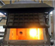
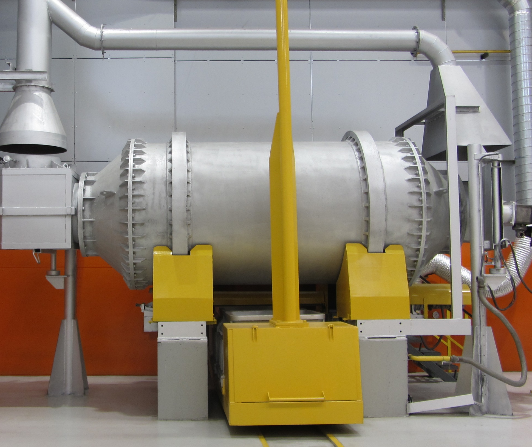
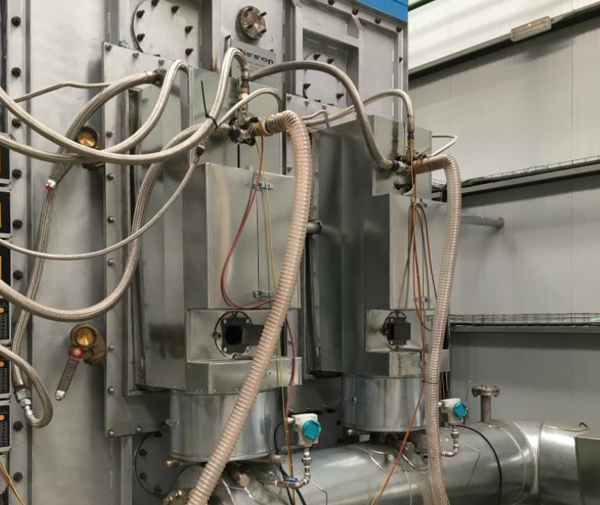
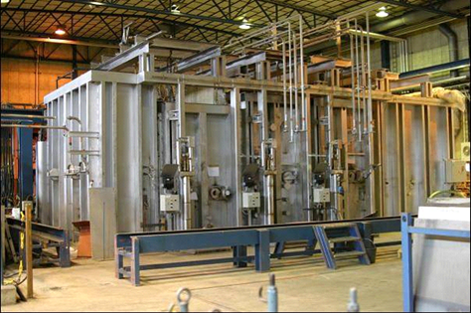
The demonstrators – part 1
Industrial size reverberatory melting furnace
Al
C-Tec, Voreppe, France | aluminium scrap remelting | retrofit from NG/O₂ to H₂/O₂ burner technology | 6.2 kt CO₂ saving for 50 kt/a remelting capacity
Al
Pilot rotary melting furnace
Befesa, Valladolid, Spain | aluminium scrap refining furnace | retrofit from NG/air to H₂/O₂ burner technology | 2.7 kt CO₂ savings for 40.5 kt/a refining capacity
Fe
Al
Pilot radiant tube furnace
ArcelorMittal, Gijón, Spain | heat treatment for steel/aluminium | retrofit from NG/air to H₂/air burner technology | 31.0 kt CO₂ savings for 550 kt/a hot dip galvanizing line
Pilot walking beam furnace
Fe
SWERIM, Lulea, Sweden | steel reheating for hot rolling | retrofit from light oil/air to H2/air/O2 burner technology | 386 kt/a CO2 savings for 3100 kt/a reheating frunace

Slide 11
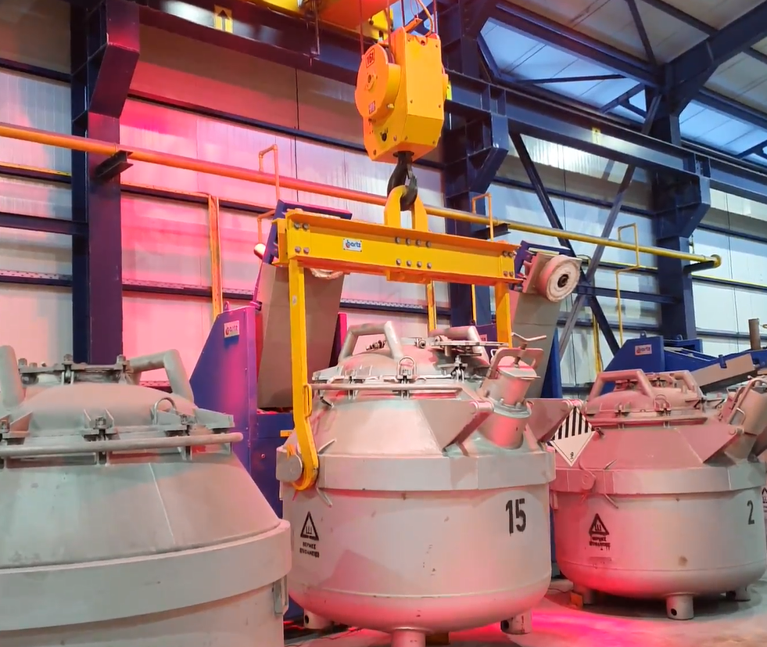
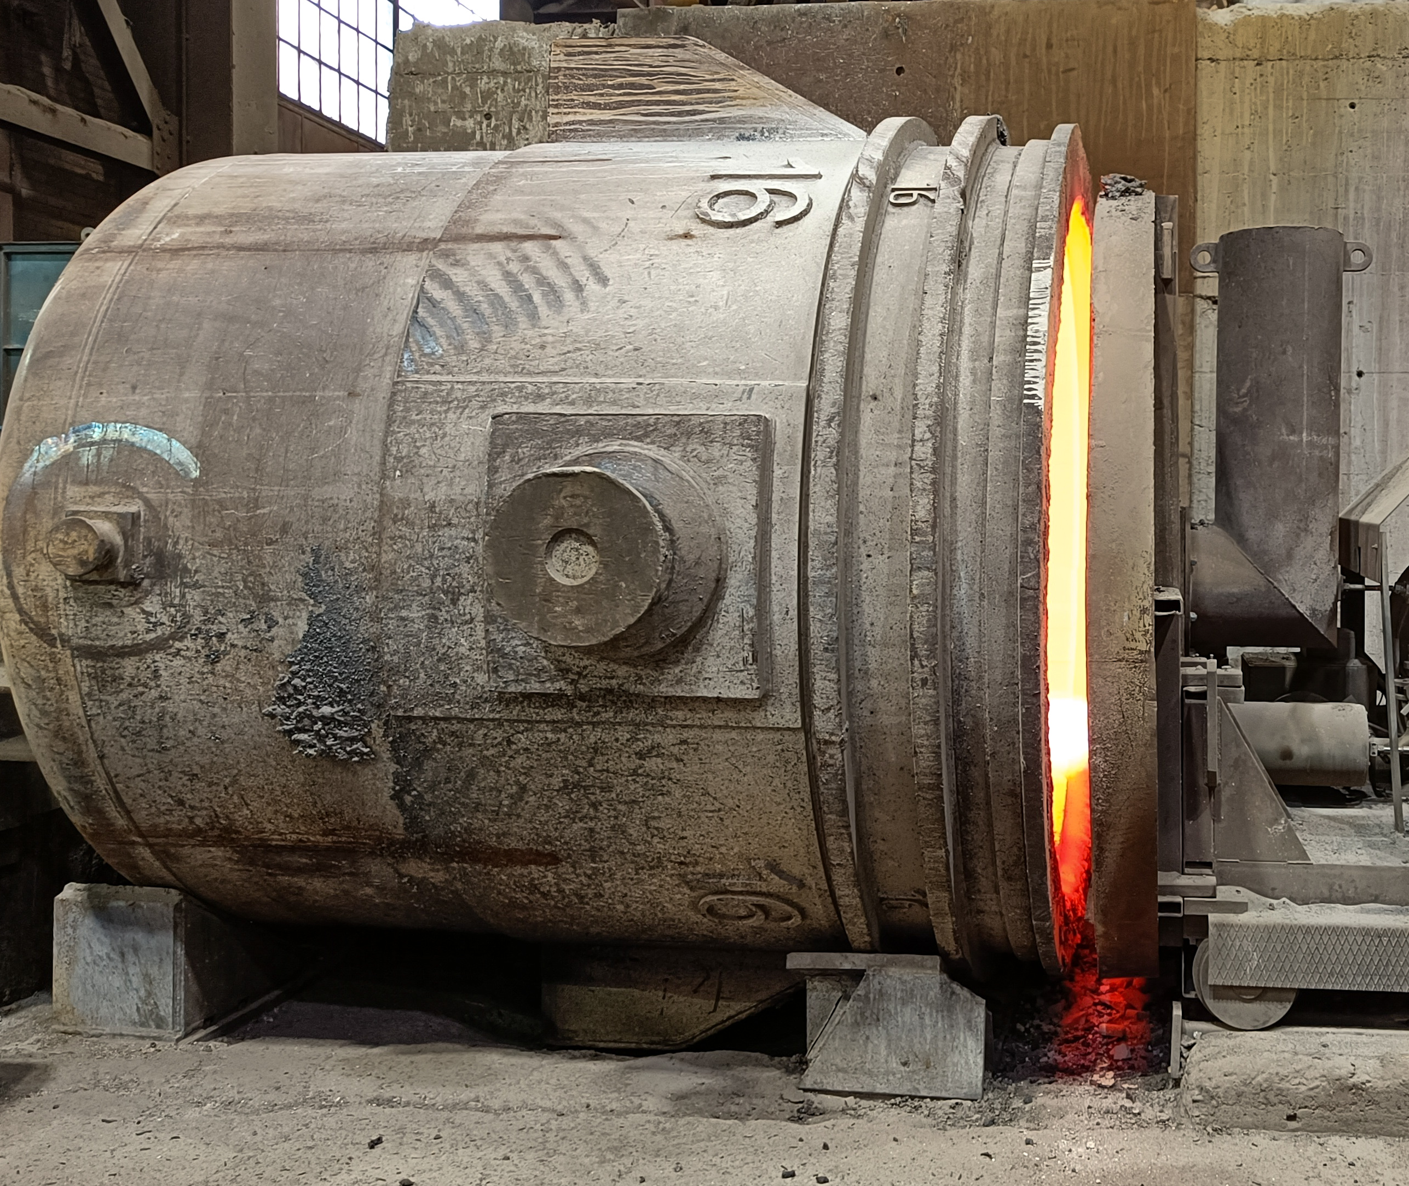
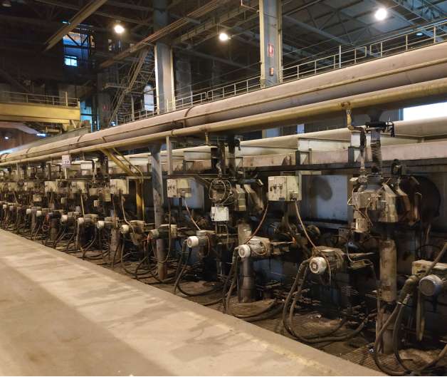
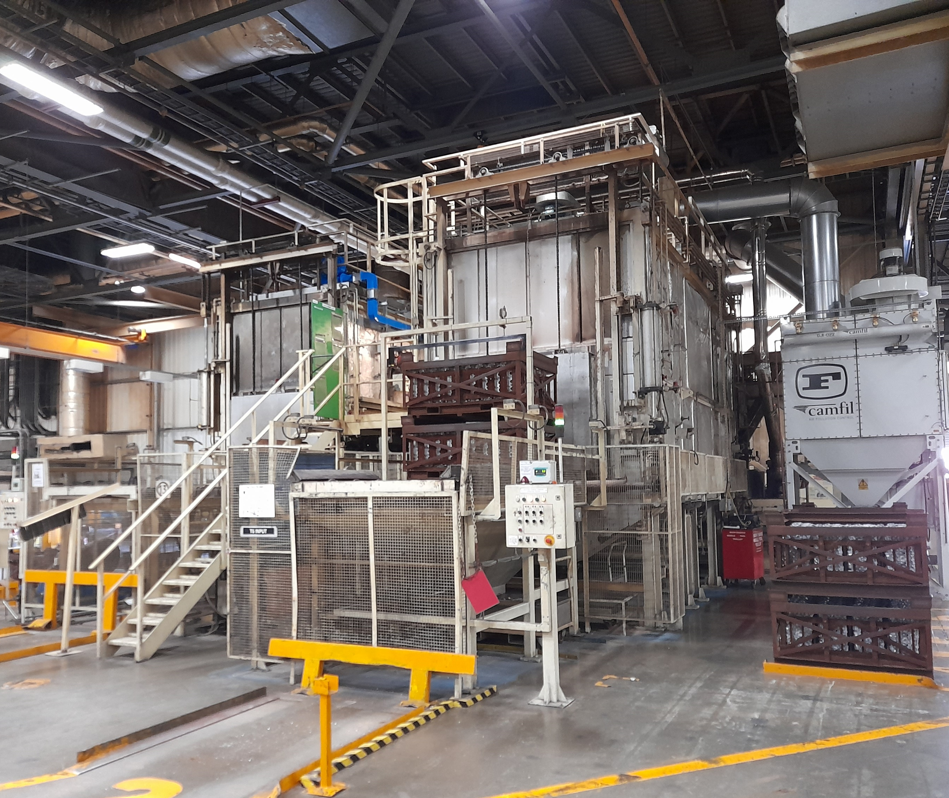
The demonstrators – part 2
Al
Industrial liquid metal transfer heater
Mytilineos, Agios Nikolaos, Greece | liquid aluminium transfer | retrofit from NG/air to H₂/O₂ burner technology | 0.3 kt/a CO₂ savings
Fe
Industrial ladle preheating station
Celsa Nordic, Mo i Rana, Norway | steel ladle preheating | retrofit from NG/air to H₂/O₂ burner technology | 5.7 kt CO₂ savings for 350 kt/a steel plant
Fe
Industrial tunnel heating furnace
ArcelorMittal, Sestao, Spain | steel thin slab heating | retrofit from NG/air to H₂/air burner technology | 90.0 kt CO₂ savings for 1600 kt/a steel coil
Al
Industrial annealing furnace
Toyota, Walbrzych, Poland | aluminium part heat treatment | retrofit from NG/air to H₂/O₂ burner technology | 0.1 kt/a CO₂ savings

Slide 12
Phase 1
Phase 2
Phase 3
The Workplan
WP 1:
Process analysis and retrofitting requirements
WP 5:
Demonstration of H₂ heating solutions in aluminium production processes
9 work packages
Phase 1: Technology development and adaption
Phase 2: Implementation and validation
Phase 3: Evaluation and analysis
Accompanying dissemination and exploitation
Consistent project and risk management
WP 2:
Modification and redesign of equipment and processes
WP 7:
Evaluation of greenfield and retrofitting solutions
WP 3:
Design of safe and efficient H₂ and O₂ infrastructure
WP 6:
Demonstration of H₂ heating solutions in steel production processes
WP 4:
Instrumentation and algorithms for measurement and control
WP 8: Communication, policy and exploitation
WP 9: Project coordination, management and reporting

Slide 13
The timing
WP No. | Work Package | Lead | 2023 |  |  |  | 2024 |  |  |  | 2025 |  |  |  | 2026
 |  |  | Q1 | Q2 | Q3 | Q4 | Q1 | Q2 | Q3 | Q4 | Q1 | Q2 | Q3 | Q4 | Q1 | Q2 | Q3 | Q4
1 | Process analysis and retrofitting requirements | TECNALIA
2 | Modification and redesign of equipment and processes | LINDE
3 | Design of safe and efficient H₂ and O₂ infrastructure | POLIMI
4 | Instrumentation and algorithms for measurement and control | SICK
5 | Demonstration of H₂ heating solutions in aluminium production processes | GHI
6 | Demonstration of H₂ heating solutions in steel production processes | CELSA
7 | Evaluation of greenfield and retrofitting solutions | NTNU
8 | Communication, policy and exploitation | EGEN
9 | Project coordination, management and reporting | RWTH

